Slide 1
Inventory Management System Project
Liam Harrold
Notes:
Hello, I’m Liam Harrold.
Welcome to my Inventory management system project.

Slide 2
Introduction
Customers, Items and Orders
SOLID Principles
Agile project management
Jira – Epics, User Stories
Notes:
IMS contains 3 tables.
Crud functionality for each table – add multiple items to an order/calculate price
SOLID Principles – focus on good design and coding methods - to create easily-maintainable, more understandable
Agile – Flexible and adaptable working environment
Jira – used to manage the sprint and clearly show what work to do/in progress/completed

Slide 3
Consultant Journey – Technologies Used
Java – Previous experience
Junit – New technology
SQL – Previous experience
JDBC – New technology
Git – New technology
Maven – New technology
Notes:
Java/SQL – uni experience

Slide 4
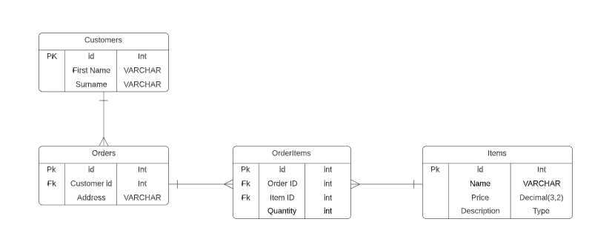
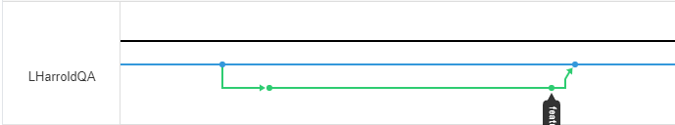
CI Pipeline
Source code/Programming Language: Java - Eclipse
Source code management: GitHub
Version Control System: Git – Feature-Branch model
Database Management System: MySQL 5.7
Build Tool: Maven
Unit Testing: JUnit
ERD
Master
Dev
Feature Branch
Feature-Branch Model example
Notes:
Cloned initial dev branch repository ’IMS-Starter’
Push any changes to github using git and feature branch model
Talk about feature branches in diagram
Discuss database ERD – how it changed
GCP
Maven
Junit – leads to next slide on testing

Slide 5
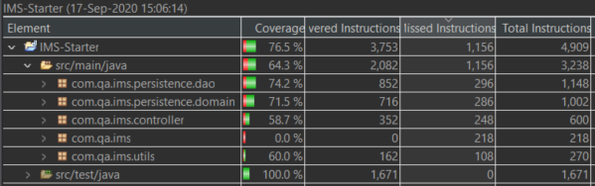
Testing
Test coverage src/main/java: 64.3%
Domain tests – Junit
DAO tests – Junit
Controller tests - Mockito
Notes:
Discuss image
Further exception tests to increase coverage of DAO class
Used Mockito template for Controller classes – not covered Mockito before

Slide 6
Code Demonstration
As a user, I would like to update a customers details
As a user, I would like to view all items in the system
As a user, I would like to create an order
As a user, I would like to add an item to an order
As a user, I would like to calculate a cost for an order
Notes:
Read user stories then give demonstrations

Slide 7
Sprint Review
Completed all user stories for minimum viable product
Left behind extension task – Users
Focussed on accuracy of project
Notes:
Completed CRUD functionality and add/calculate cost order
Left extension behind to focus on accuracy and correctness of project
Needed time to complete testing
Some documentation to complete as well which reduced time to do extension

Slide 8
Sprint Retrospective
What went well?
Followed user stories in logical way
Requirements met
Flexible timings
Future Improvements
Usage of feature-branch model
Notes:
Flow of working was good
Met the minimum viable product spec
Managed my timings well – didn’t spend too long on simpler tasks (domain class) allowed more time for SQL statements etc
Found myself just working on the dev branch to implement new features
First time using the branch model – when used I used it well

Slide 9
Conclusion
Thoughts
Happy with how I worked
Consolidation of skills being taught
Overcame issues well
Further steps
Add a user/login system
Use GCP for database
Create a front-end
Notes:
Never felt panicked or overstressed
Issues – how I thought I had a solution but then had to change database configuration

Slide 10
Thanks for Listening
Any QUESTIONS?

